Slide 1
SALARY AND ATTENDANCE MANAGEMENT SYSTEM
GROUP MEMBERS:
1)B.M. ABIR (I.D#12201022)
2)TALHA SIDDIQUE (I.D#12201026)
3)ARNAB SARKER (I.D#12201090)
COURSE:
CSE 370, SEC#03

Slide 2
FEATURE LIST:
Attendance Log
Individual Employee Information:
Name
Address
Hours Worked
Salary Information

Slide 3
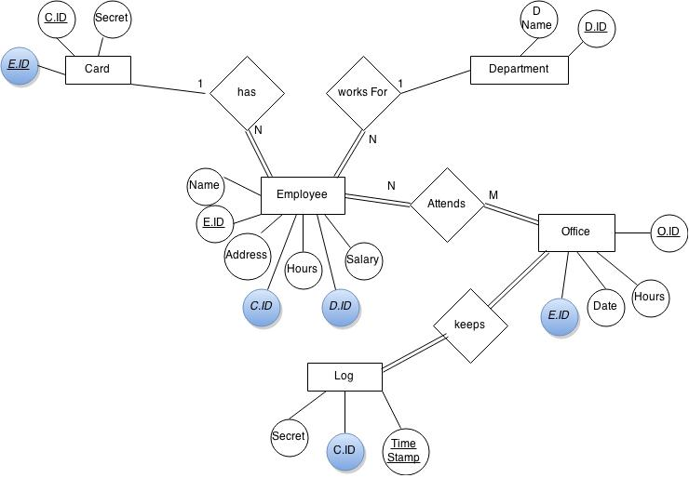
ER DIAGRAM:

Slide 4
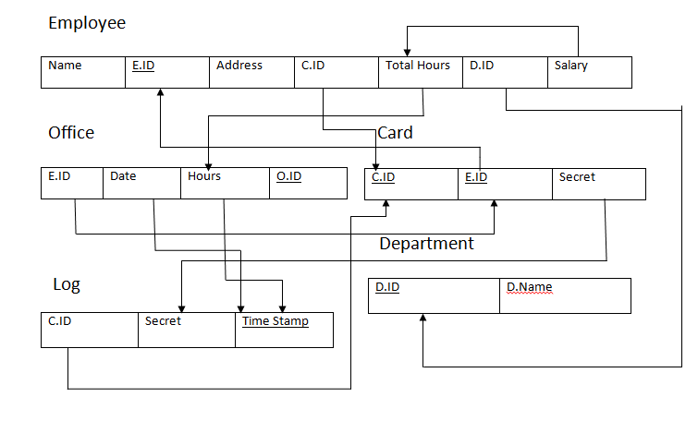
SCHEMA

Slide 5
QUERY LIST:
To update the C.ID of the Employee column after adding a new card:
UPDATE `Employee` SET `C.ID` = ( SELECT `C.ID` FROM `Card` WHERE `Card`.`E.ID` = '12201011' ) WHERE `E.ID` = '12201011‘
To find all Employee data from the database using the Employee ID provided by the user:
SELECT * FROM `Employee` JOIN `Card` ON `Employee`.`C.ID`=`Card`.`C.ID` JOIN `Department` ON `Employee`.`D.ID`=`Department`.`D.ID` WHERE `Employee`.`E.ID`=$_POST["ID"]
To add new Employee to the database:
INSERT INTO `unisecbd_rfid`.`Employee` (`E.Name` ,`E.ID` ,`Address` ,`Hours Worked` ,`Salary` ,`C.ID` ,`D.ID`) VALUES ('Asif', '12201011', '79/1 Mohakhali', '8.000', '84.000', NULL , '1');
INSERT INTO `unisecbd_rfid`.`Card` (`C.ID`, `E.ID`, `Secret`) VALUES (NULL, '12201011', 'assassin32');
To add log to the office table:
INSERT INTO `unisecbd_rfid`.`Office` (`Hour`, `O.ID`, `Date`, `E.ID`) VALUES ('1.500', NULL, '2015-04-04', '12201011');

Slide 6
Sum of office hours:
SELECT SUM(`Office`.`Hour`) FROM `Office` where `Office`.`E.ID`='12201022';
Get the sum of hours for the last office entry:
SELECT SUM(`Office`.`Hour`) FROM `Office` where `Office`.`E.ID`=(SELECT `Office`.`E.ID` FROM `Office` ORDER BY `O.ID` DESC LIMIT 1);
Update the Employee Table of 'Hours Worked' by calculating from 'Hours' of Office Table:
UPDATE `Employee` SET `Hours Worked`=(SELECT SUM(`Office`.`Hour`) FROM `Office` where `Office`.`E.ID`=(SELECT `Office`.`E.ID` FROM `Office` ORDER BY `O.ID` DESC LIMIT 1)) WHERE `Employee`.`E.ID`=(SELECT `Office`.`E.ID` FROM `Office` ORDER BY `O.ID` DESC LIMIT 1);
Update the Employee Table of `Hours Worked` and `Salaries by calculating from 'Hours' of Office Table`:
UPDATE `Employee` SET `Hours Worked`=(SELECT SUM(`Office`.`Hour`) FROM `Office` where `Office`.`E.ID`=(SELECT `Office`.`E.ID` FROM `Office` ORDER BY `O.ID` DESC LIMIT 1)),`Salary`=(SELECT SUM(`Office`.`Hour`) FROM `Office` where `Office`.`E.ID`=(SELECT `Office`.`E.ID` FROM `Office` ORDER BY `O.ID` DESC LIMIT 1))*500 WHERE `Employee`.`E.ID`=(SELECT `Office`.`E.ID` FROM `Office` ORDER BY `O.ID` DESC LIMIT 1);

